Slide 1

YOU Make a Difference Pins- Recognition Program
By: Nancy Blum and Angela Lohse
Winona State University

Slide 2
Origins
Developed by Winona State NRHH chapter to promote campus wide recognition
Developed to increase knowledge of the NRHH chapter
Used as the September Recognition/Service program for the month
Ideas behind program:
  Starfish Story
  Similar Programs

Slide 3

Goals
Recognize people for the good things they do within residence halls and throughout campus.
Increase the knowledge of what NRHH represents.
Increase the campuses knowledge of NRHH.
Allow members to spread recognition at a one-on-one basis.

Slide 4

You Make A Difference NRHH Pins!
Congratulations on receiving a “You Make a Difference” pin. Thank you for all you do for our campus and our residence halls. Please read the piece of paper attached to your pin for further information on National Residence Hall Honorary (NRHH) and instructions for when to wear your pin.

Slide 5
Passing on the Pins!
Once you receive your pin please feel free to wear it anytime!
If there are still pins left in the bag please find someone that you feel makes a difference on campus and in the residence halls.
Present this person with their pin and the remainder of the pins in the bag.
Keep passing the bag along until there are no more pins. (Please do not accept more than one pin.)

Slide 6
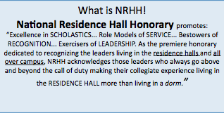
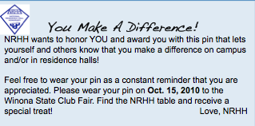
Attachments: attached to pins

Slide 7
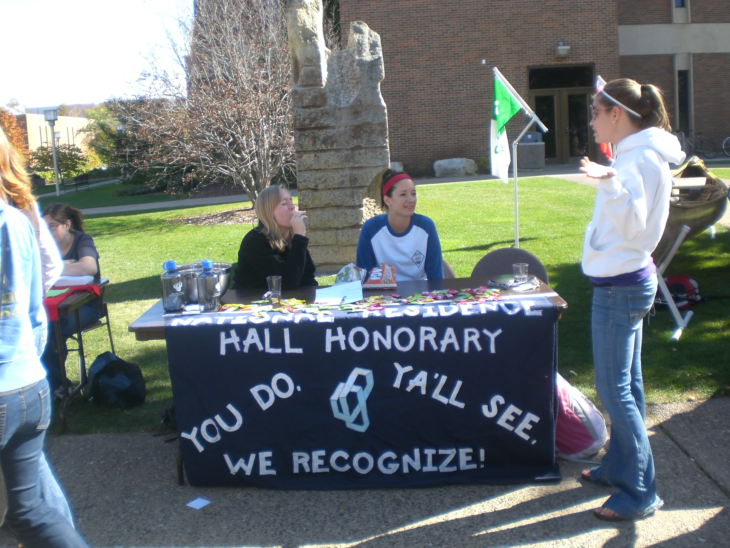
Organization
Designing Pins
Ordering Pins
Designing Informational Sheet and Attaching to Pins
Table Set-Up and Manning Table Time
*Table was set up during WSU club fair

Slide 8
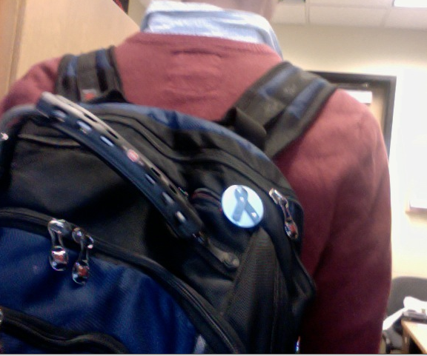
Participation:
17 NRHH Members were given bags to pass along
RHA members all received pins
Club Fair Attendance:
  Candy awarded as treat for wearing your pin!
  60 people wore their pins to our table
    More were attached to backpacks and others were seen on campus but were unavailable to stop by.

Slide 9

Improvements or Adaption to Your School
Bracelets or ribbons
Give less pins in each bag
Extend length of program
Take names of people that receive pins – email?

Slide 10

Thank You!
Contact
NRHH@winona.edu
for more information

Slide 11
Past/ Similar Program Video:
  http://www.acknowledgmentmovie.com/
  Originally developed by a teacher to recognize students.
  She wanted to complete a study of how recognition will affect someone’s everyday life.
  Challenged students to go out in their community to spread the message that everyone makes a difference.
  Spread to a local company, ribbons being passed between students, executives and bosses of companies.
  Story continues to explain that a once grouchy man presents a ribbon to his son, who had been contemplating ending his life. The recognition from his father changed his life and his father’s life.

Slide 12
Starfish Story:
  A man was jogging down the beach after a major storm had just come through the area. The huge number of starfish that the storm had washed up on the beach dismayed him. He thought there was nothing he could do because of the immense numbers. As he continued down the beach, he noticed an older man in the distance throwing something in the water. As the jogger got closer, he saw the old man walk a little farther down the beach, bend over, pick up a starfish and throw it back in the water. As the jogger approached, the old man stopped, bent over, picked up another starfish and began to throw it back in the water. The jogger interrupted, “Why are you doing that? There are thousands of starfish on the beach. You can’t possibly make a difference.” The old man looked at the jogger, then at the starfish and threw it back into the water. Looking back at the jogger, the old man replied, “I made a difference to that one, didn’t I?”

