Slide 1
MACURH TEA GARDEN
Maria Doblemann & Damian Chavez

Slide 2
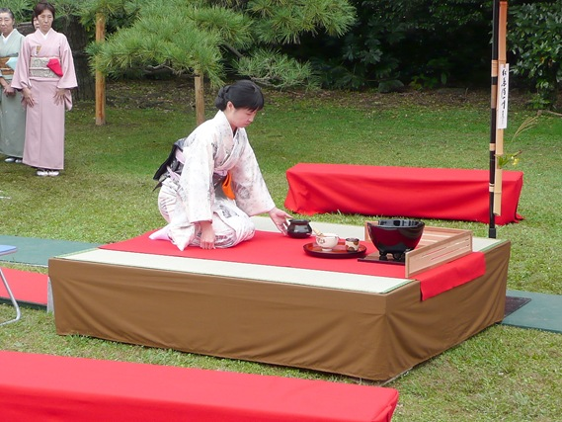
Venue – Nodate

Slide 3
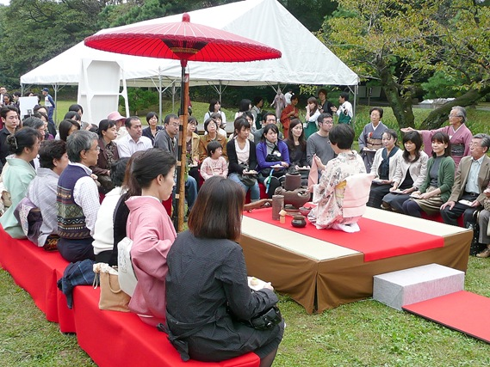
Venue – Nodate

Slide 4
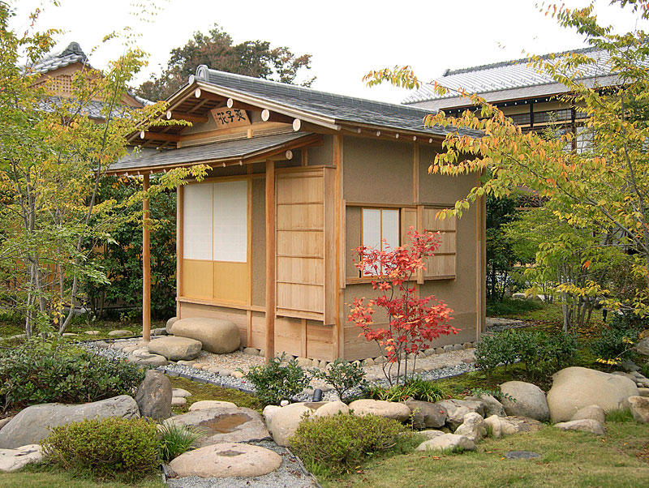
Venue – Chashitsu

Slide 5
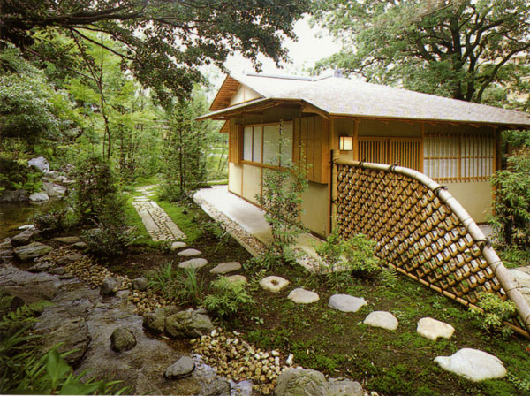
Venue – Chashitsu

Slide 6
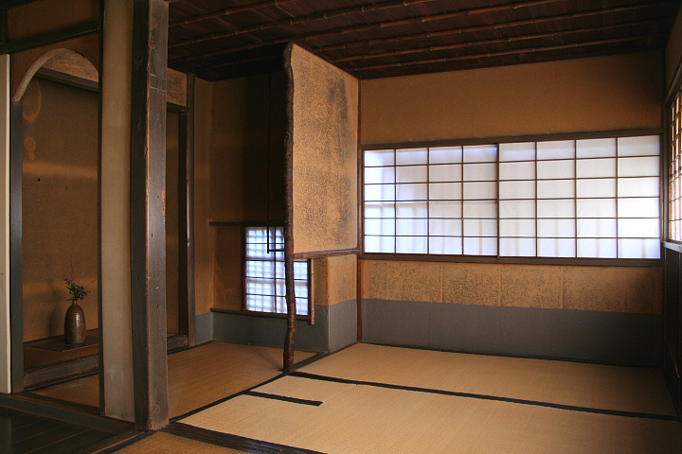
Venue – Chashitsu

Slide 7
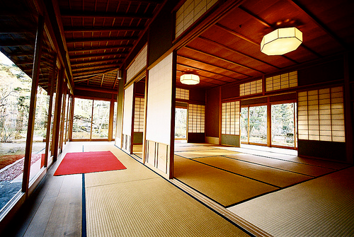
Venue – Chashitsu

Slide 8
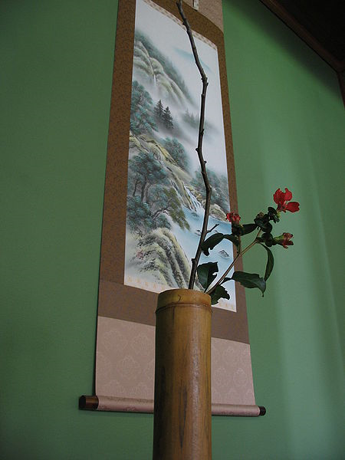
Chabana

Slide 9
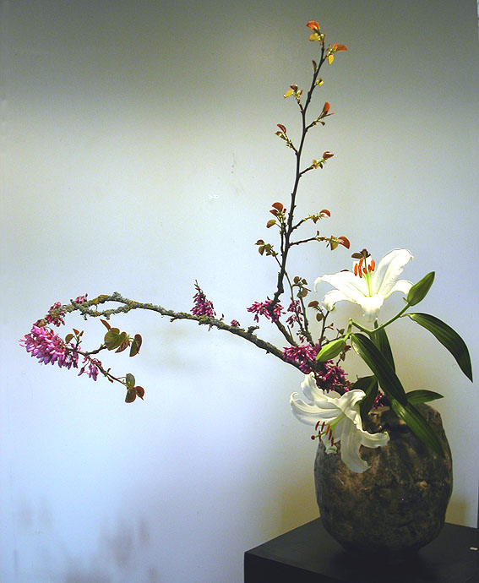
Chabana

Slide 10
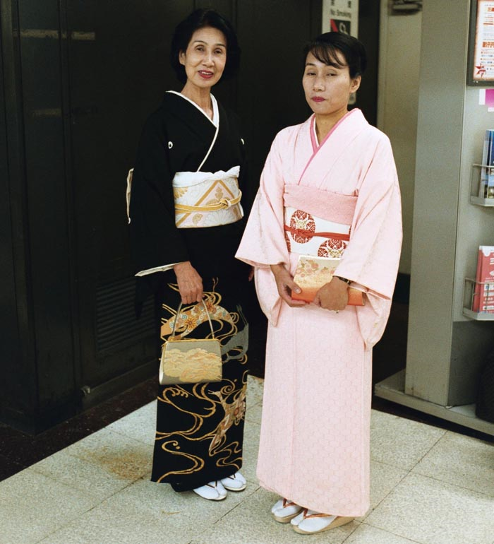
Attire – Women

Slide 11
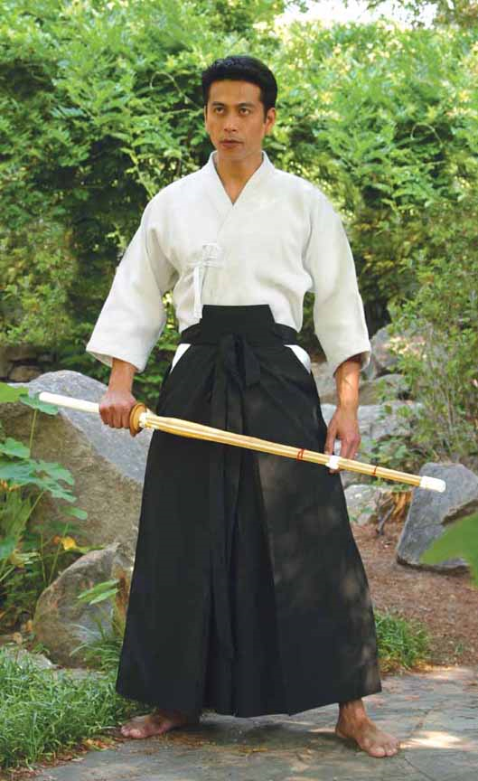
Attire – Men

Slide 12
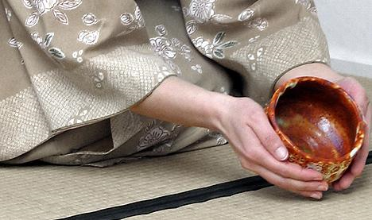
Equipment – Chawan

Slide 13
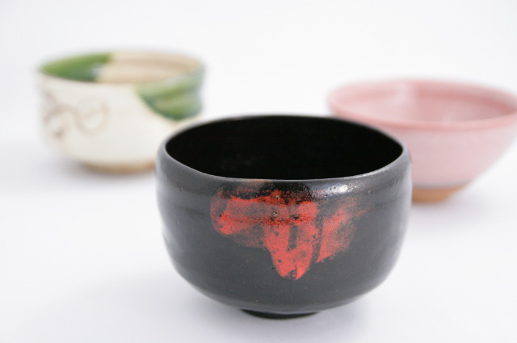
Equipment – Chawan

Slide 14
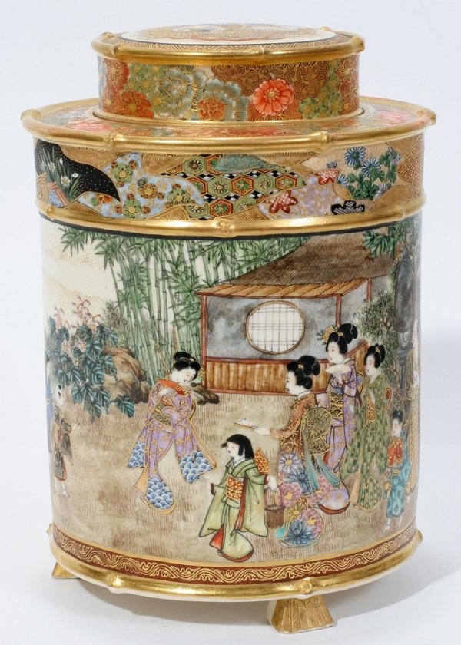
Equipment – Chaki

Slide 15
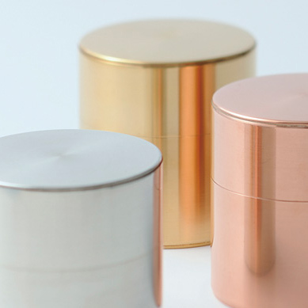
Equipment – Chaki

Slide 16
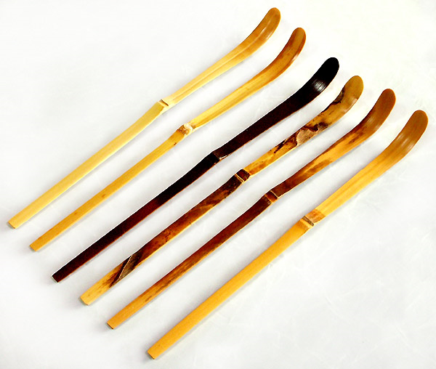
Equipment – Chashuku

Slide 17
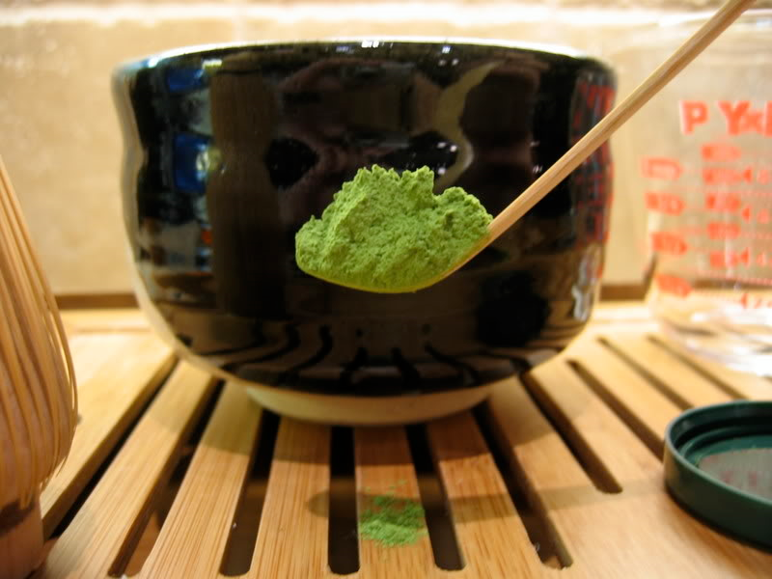
Equipment – Chashuku

Slide 18
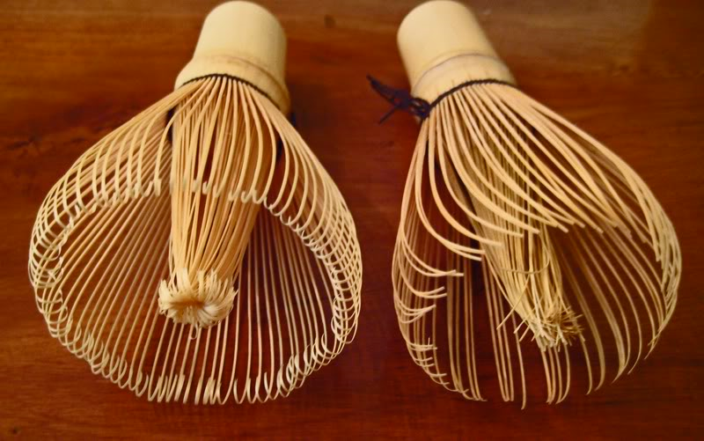
Equipment – Chasen

Slide 19
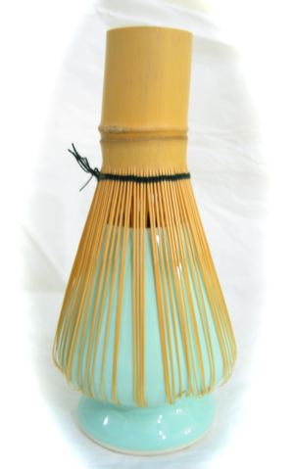
Equipment – Chasen

Slide 20
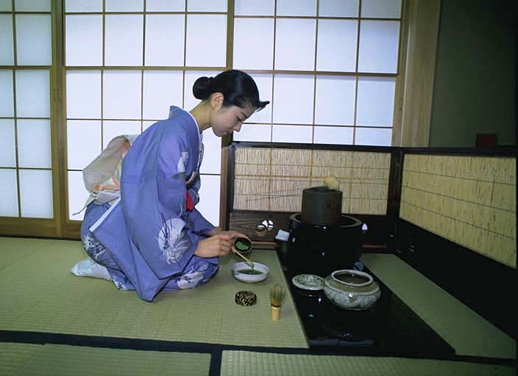
Ceremony

Slide 21
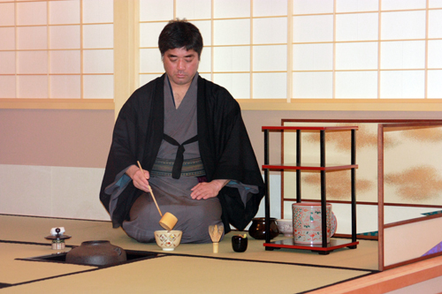
Ceremony

Slide 22
Questions

