Slide 1

The Price is Always Right
Presented by: Dustin Dye & Kat Clark
University of Nebraska at Kearney

Slide 2

What is the importance of Programming/Event Planning?
Student Engagement
Educate
Empower
Let’s be REAL can programming really be free?
Yes it Can!
Pinky and the Brain

Slide 3


Steps to Completing A Successful Program
Assessment
Initial Planning
Planning for
Details
Advertising
  Social Mediums http://goanimate.com/
Showtime
Evaluate
Tips
Commitment to your idea
Passing the Buck
Delegating Tasks
Big ideas first, little details later

Slide 4
Resources on Campus
A) Advertising, Marketing, Equipment
Advertising
  Where are you going to be advertising?
  What is the best way?
  Advertising for what?
Marketing
  Who is the event or program for?
Equipment
  What do you need?
  Who has it?
  How do you get it?

Slide 5
Resources on Campus
B)Room Reservations & Requesting funds from Organizations
Room Reservations
  Call Ahead of time
    3-4 weeks
  Tell them about the event and your organization
  Ask what they can do for you? (vice versa)
Requesting Funds
  Always make sure what the guidelines are, every organization is different.
  As for documents needed to complete

Slide 6
Resources on Campus
C)On Campus Professional Development Funds & Red Flags
On Campus Professional Development Funds
  Sponsors at your school
  Pepsi
    Application Requirements
    Proposal/Grant
Red Flags
  Liability
  Policies
  Contracts

Slide 7

Resources in One Another

Slide 8
Now the Part you’ve all been waiting for…
Here’s how to make it free!
Why would we get donations from the community?
What donations are appropriate to ask for?

Slide 9
Asking for Donations
Here’s How
  Tell a Story
  Break the Rules of Grammar
  Provide and Easy Way to Respond
  Give Suggestion
  Follow Up

Slide 10
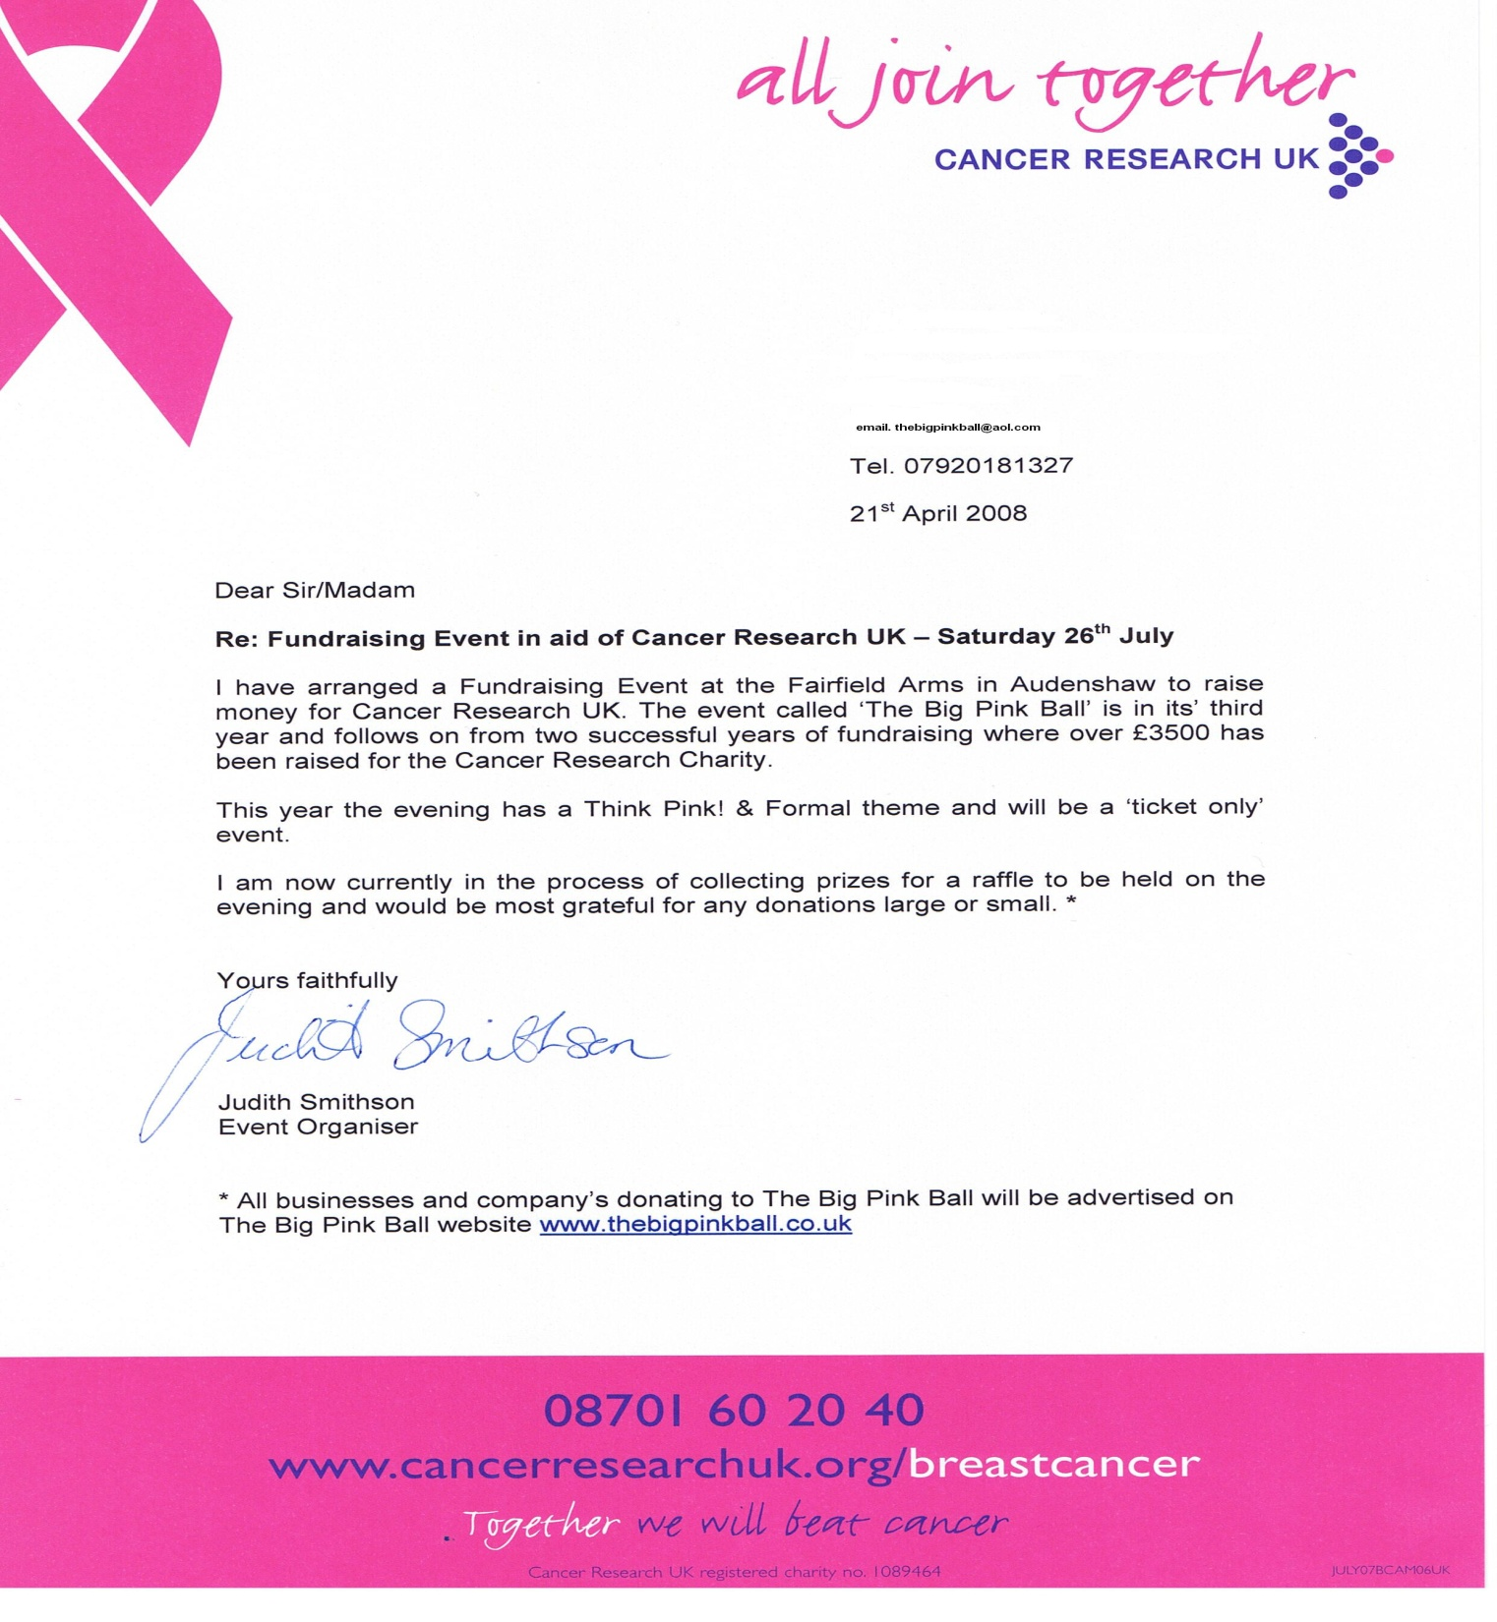

Slide 11

Accepting Donations With Style
P. I .F. F.
Phone Etiquette
Introduction
Formalities
Follow up

Slide 12
Businesses we know Donate
Wal-Mart
Fast Food Chains
Local Businesses
Franchise Restaurants, varies.
Sporting Good Stores
Jewelry Stores

Slide 13
Resources for Leaders
http://www.emergingleader.com/aboutus.shtml
http://www.leader-values.com/default.asp
http://www.asgaonline.com/ME2/Audiences/dirsect.asp?sid=7F31AE8077DB44A5A60AF114B68E9153&nm=Home&AudID=B7353D3A67F945B58C57DBC83B9C459E
http://wellness.ucsd.edu/survey/
http://www.residentassistant.com/one/index.php

Slide 14
Now It’s Your Turn!!
Phone Interview Skits
Sharing of Ideas

Slide 15
CONTACT US!!!
If you have any questions over anything, or need something to be cleared up please feel free to contact either of us.
Kat Clark: clarkkj2@lopers.unk.edu
Dustin Dye: dyeda@lopers.unk.edu

Slide 16


