Slide 1
Mr. Prentiss Pageant
Presented by:
Winnie Jaworski and Stephanie Wick
Winona State University
Notes:
Steph:
Welcome to the presentation of our Mr. Prentiss Pageant! My name is Steph Wick and this is my fellow council member, Winnie Jaworski. We’re both Warriors from Winona State University and are also really happy to be here to share the success of our favorite program so far.
Winnie:
We live in Prentiss-Lucas Hall, where the girls reside in Lucas and the boys reside in the connected building, Prentiss. To get both the boys and girls involved in our residence hall, we decided to have an all-boys mock pageant, which brought both genders in to watch the hilarious show. Trust us: if you’re able to get 7 guys to dress as girls, perform a ballet-ribbon dance, serenade a crowd, and prepare an epic rock-n-roll PB&J sandwich, the girls will come running.

Slide 2
Origin
Programs at Winona State University must meet one of these four requirements:
    Social, Educational, Diversity, and/or Service
The Mr. Prentiss Pageant fit into the Social and Service categories, but can be altered to meet other standards, as well.
Notes:
Steph:
To get the ball rolling, we’ll start by explaining the origin of our program. Programs at Winona State University must meet one of these four requirements: Social, Educational, Diversity, and/or Service. The Mr. Prentiss Pageant fit into the Social and Service categories. We wanted to make entertainment for our residents while also raising money for St. Jude’s Children’s Hospital for admittance.
At your school, by making your own personal changes, this pageant could also be altered to meet your standards, as well.

Slide 3
Goals
Build confidence and unity among residents
Provide entertainment for residents
Raise money for St. Jude’s Children’s Hospital
Notes:
Winnie:
We had three main goals for this program. Since it was the first month of school, we thought that this would be a great way to break the ice between residents. By attending this program and getting to know the contestants and others attending, we would become closer as a residence hall. The boys participating also built some self confidence with the massive amount of cheering they received.
Steph:
We also wanted to provide entertainment for our residents, and by incorporating some fun into the show, we hoped this would happen.
On PR and by word of mouth, we suggested to all people attending to bring spare change to put into the bucket for St. Jude’s Children’s Hospital.

Slide 4
Advertising and Budget
Advertising
Budget
PR in Residence Halls
Door Knocking
Word of Mouth
Chips
Pop/Water
$30 Gift Card
Bags of Candy
Gifts for Judges
Notes:
Winnie:
Advertising this event didn’t cost much for us. We worked hard on home-making three big posters for advertising: one in the lobby, one on the Prentiss side that said “support your boys” and one on the Lucas side that said “find your dream guy.” The big posters were black silhouettes of a man holding colorful posters that advertised the pageant.
We also went around the night of the pageant in our residence hall and used door knocking and word of mouth to get people to attend.
Getting the guys involved to talk about it with their friends also encouraged a lot of people to come and support.
Steph:
Fortunately, we didn’t have to spend a lot of money on this program… we bought chips and refreshments for the guys backstage, although many were too nervous to eat. We also spent $30 to buy a gift card to the bookstore and also about $15 worth of candy for our winners. We wanted to honor our judge’s time so we decided to buy little presents for them to take home, as well. This pageant, if you don’t have to pay to use a venue, could easily be done in under $60. Not to mention that it’s worth every penny.

Slide 5
Outline of Pageant
Introduction
Fishbowl Questions
Talents
Results
Notes:
Winnie:
We followed this main outline for our pageant, starting with introducing the show, hosts, boys, and charity we were raising money for. The boys were judged on poise, creativity, and audience involvement through the fishbowl and talent portion of the show. And lastly, we gave the results of Mr. Prentiss, 1st Runner Up, and Mr. Congeniality, in which the contestants voted on before the show.

Slide 6
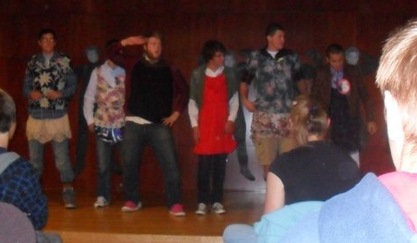
Introduction of Candidates
Slide Show and Dress Up Game
Notes:
Steph:
We would love to now walk you through the show, so that you can picture your own pageant in your residence hall. Let’s start with the Introduction of the Candidates, where we used a slide show and surprise game to start the show.

Slide 7
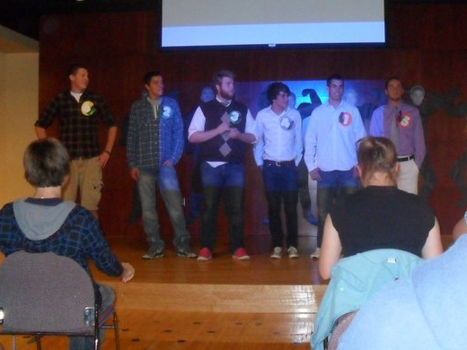
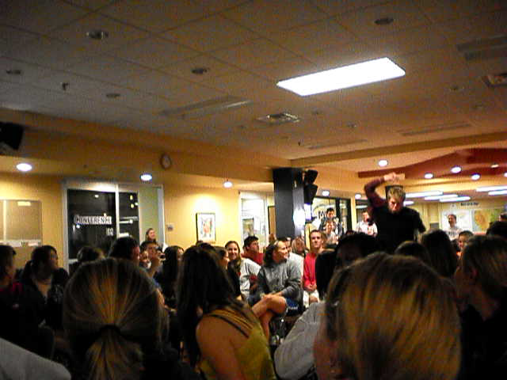
Introduction of Candidates
Slide Show
Dress Up Game
Notes:
Steph:
We had candidates fill out a survey in preparation of the show and we used their answers to collaborate them into a slide show filled with fun facts and stories about the past of the boys. We played and narrated this in the opening, before bringing them out. Using a unique survey keeps the answers fun and entertaining. While on their way out, we also had each candidate give a rose to one person in the audience. We had the receivers stand up and told them that someone was very happy they came tonight. This was a great way to get the audience involved.
Winnie:
The boys and the audience found out at the same time that we were going to introduce them in a very unique way. We set a pile of girl clothes at the opposite end of the isle to reach the stage. Each boy had to run, put on their cutest outfit, and “strut the catwalk” back to the stage. From there, they gave their best pose until the others arrived. We will now give you a little preview of what the contestants came up with… (play movie) After everyone got back to the stage, they introduced themselves to the audience and left as a group to prepare for the fishbowl question portion.

Slide 8
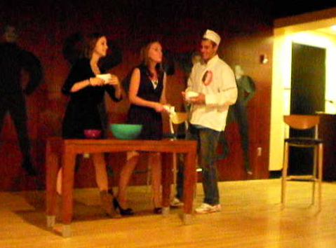
Fishbowl Questions
Dream Date and Truth or Dare
Notes:
Winnie:
The next portion of the show was the Fishbowl Questions Portion, where we got to know more about each candidate, using the Dream Date and Truth or Dare exercises.

Slide 9
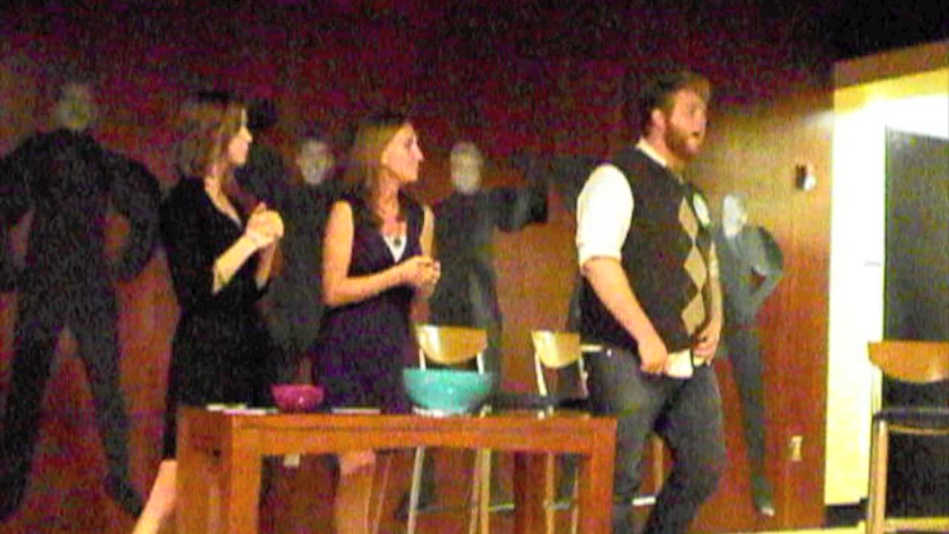
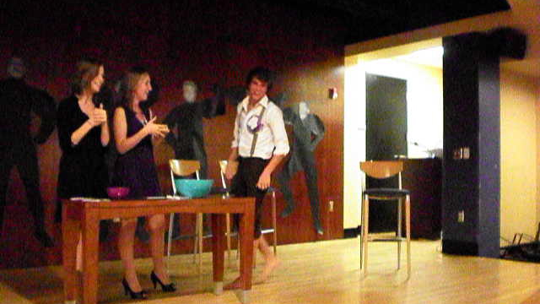
Fishbowl Questions
Dream Date
Truth or Dare
Notes:
Winnie:
To open the Fishbowl Question portion, each contestant came out dressed as they would for their dream date. They then were asked to tell us about how they would steal the heart of the girl they would take out. Take a look at what our winner came up with… (play video)
Steph:
After each dream date explanation, the contestant was asked to draw and answer three fishbowl questions. We tried to use silly, mock questions, like “What is the meaning of life?” and “What do you love about your grandma?” When the contestant was done answering their three questions, they then had to draw out a dare out of a different bowl. These dares ranged from “Either bend and snap or pop lock and drop it,” and “Propose to someone in the audience.” Overall, we tried to keep this section based on humorous and awkward situations to keep up the entertainment level of the show.

Slide 10
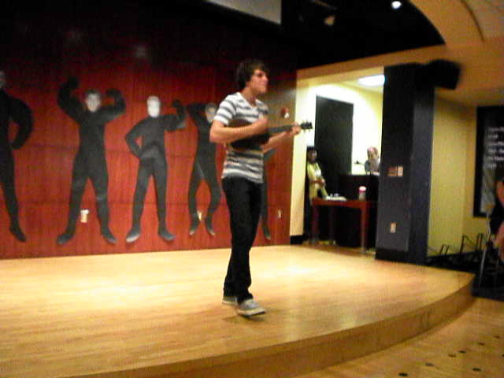
Talent Portion
Ribbon Dancing and Skateboard Breaking
Notes:
Winnie:
Next, we have our last, but definitely not least, category of judging: the Talent Portion, where even with limitations, the sky is the limit for what you might see.

Slide 11
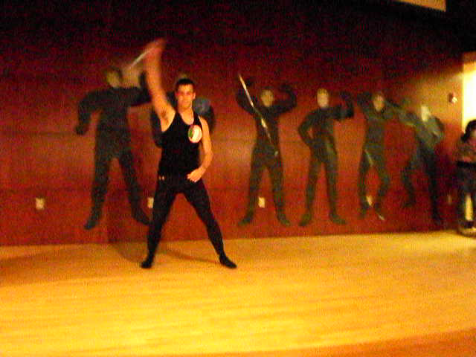
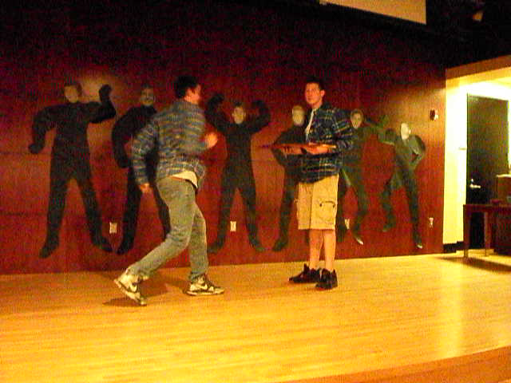
Talent Portion
Notes:
Steph:
Like Winnie said, the talent portion led us to an exciting, unveiling side of the boys that wouldn’t have been expected before the show. We put a few restrictions on the talent portion: they had 3 minutes per contestant, and could do talents together, at their own risk of not having stage time alone. Some candidates were a little stage freight though, so we wanted to make sure that everyone would be comfortable participating in the pageant by giving them this option. We also made sure that we knew exactly what the contestants would be doing on stage to prevent any funny business or under the belt humor.
Take a look at a few talent examples from the night of our Mr. Prentiss Pageant… (play movies)

Slide 12
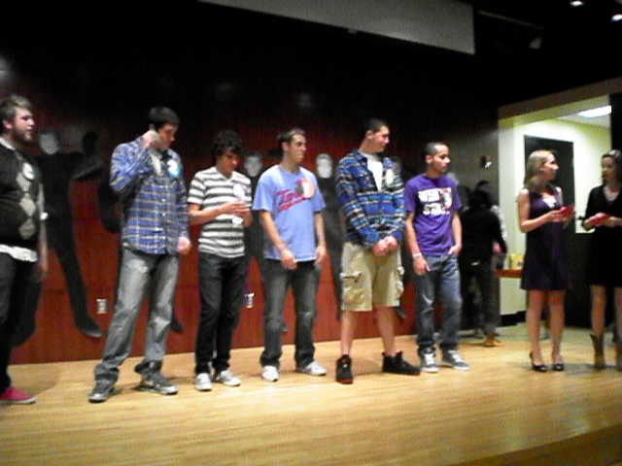
Results
Thank Yous and Awards
Notes:
Winnie:
To end the show, we thanked all of our judges and the audience for their time. We then gave out awards. One went to Mr. Prentiss, who got $30 to our bookstore, a ride on our homecoming float, and their picture in our lobby. We gave a big bag of candy to the 1st Runner Up and little bags of candy to our Mr. Congeniality, who’s title was voted on by the guys and kept from the contestants until the end of the show.

Slide 13
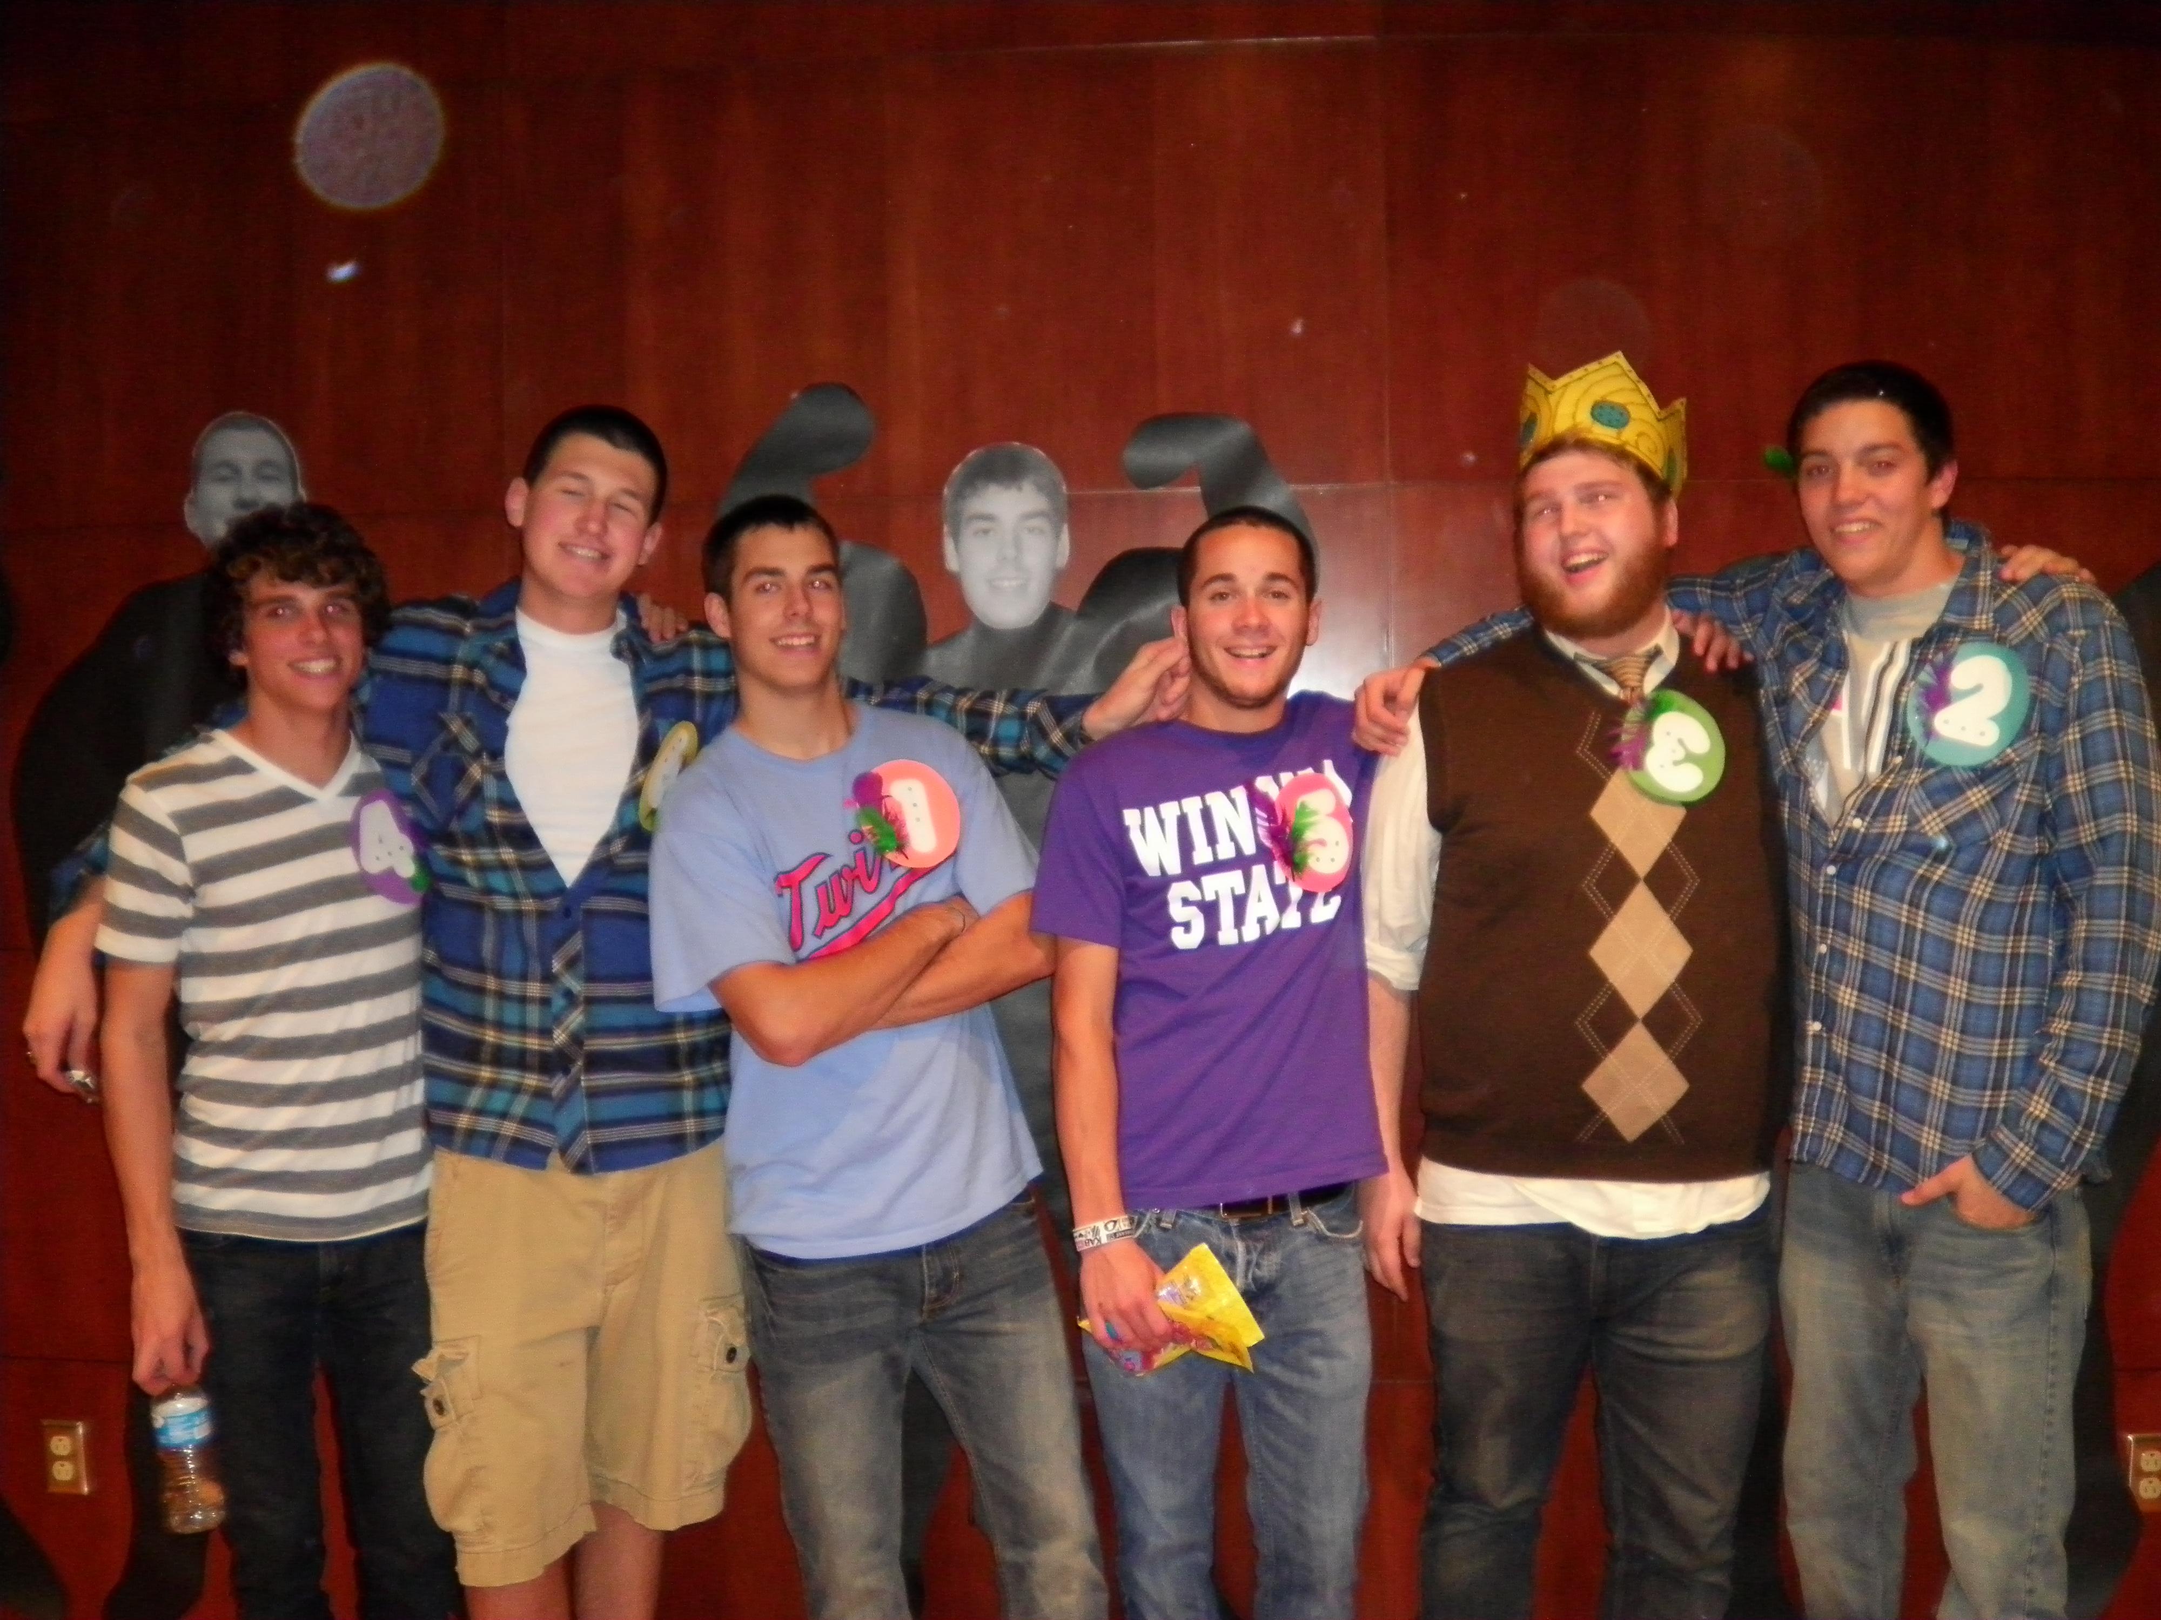
Success or Failure?
Notes:
Steph:
So, overall: was this program a success or failure?
Resident Assistant’s in our building, audience members, judges, and contestants all say success!
We were able to raise over $60 for St. Jude’s Children’s Hospital and entertained a full house.
Although we believe that our Mr. Prentiss Pageant was a success… there are a few things we would suggest for improvements.

Slide 14
Improvements
More advertisement
Increase girl involvement
Use a small number of committed contestants.
Notes:
Winnie:
Although we had a great turn out, it would have been great to have fliers hanging around campus for the show. I would suggest to get going on advertisements right away.
We found that the audience make up was mostly females, but to get these girls more involved, we talked about having a drawing to be a guest judge. This among other possibilities could have done so.
We also had a few small issues with a couple boys who dropped out of the contest, but it ended up benefitting the pageant, for 7 contestants was a perfect number to keep the show at an appropriate length.

Slide 15
Thank you for your time!
Contact RHA@winona.edu for more information!
Notes:
Steph:
All in all, we are extremely proud of our program and hope that we can spread our success and ideas to you through MACURH.
Winnie:
Thank you so much for listening… please contact us if any more information is needed. Thank you.

