Slide 1
Lessons of Leadership from Poker, Caribbean Islands, and Fiery Lava Pits
Presenters:
Nick Rolston
Sean Carruthers
Sean Ryan

Slide 2
Introduction!
Duration: ~ 2 minutes

Slide 3
Musical Chairs!
Let’s get this started with some musical chairs!
Duration: ~ 5 minutes

Slide 4
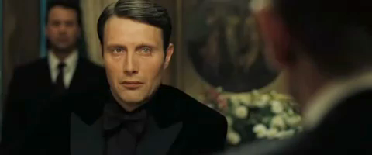
Poker!
Poker activity
  I) Organize Delegates!
  II) Explain Activity!
  III) Pass out Materials!
  IV) Discussion!
Duration:
  ~ 15 minutes

Slide 5
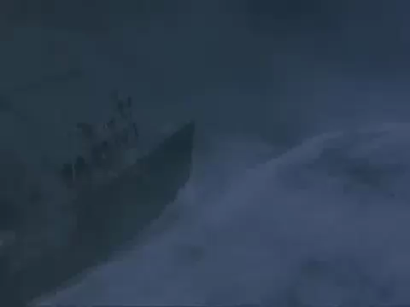
Caribbean Island!
Pass out handouts
Introduction
  Individual work
  Group work
Discussion
Duration:
  ~ 15 minutes

Slide 6
Caribbean Island - Expert
INDIVIDUAL |  |  | ACTION ALTERNATIVES | TEAM
STEP A Your Rank | STEP B Expert Rank | STEP C Difference A to B |  | STEP D Team Rank | STEP E Expert Rank | STEP F Difference D to E
 | 4 |  | Develop techniques for signaling |  | 4
 | 7 |  | Send representatives to nearest inhabited island |  | 7
 | 8 |  | Stay where you are and do nothing until the storm passes |  | 8
 | 6 |  | Search for food and water |  | 6
 | 3 |  | Seek shelter in a cove |  | 3
 | 1 |  | Give first aid to the injured |  | 1
 | 5 |  | Look for vantage points for signaling |  | 5
 | 2 |  | Decide on a leadership and planning strategy |  | 2
STEP G YOUR ACTION TOTAL |  |  |  | STEP H TEAM ACTION TOTAL

Slide 7

Fiery Pit of Doom!
Organization
Instructions
Execution
Discussion
Duration: ~ 10 minutes

Slide 8
Wrap-Up!
Some wrap-up and recap
Duration: ~ 3 minutes

