Slide 1

Scholarship Hall Olympics
University of Kansas
Brian, Robert, Kat

Slide 2
Scholarship Hall Olympics
Competing
Uniting
Bonding
Adjusting

Slide 3
C.U.B.A
Competing- The Scholarship Hall Olympics offer a great way to compete with students around you, while having fun and competing in events that interest you
Uniting- While you are competing with other scholarship halls, you still attend the same university. You meet a lot of new people from these halls and learn more about their individual culture
Bonding- You feel a special bond within your own hall. Everybody wants to win the competition, and you support each other and want the best outcome
Adjusting- The transition from high school to college is a very difficult one. The Scholarship Hall Olympics help you assimilate into college life by meeting new people, getting to know the other halls, and learning about the campus

Slide 4

What is it?
The Scholarship Hall Olympics is a competition uniting all the scholarship halls at the University of Kansas through a variety of unique events and activities
It has become a tradition and has been around for around 30 years

Slide 5
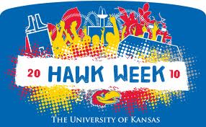
Characteristics
It occurs at the beginning of the year during Welcome Week at the University of Kansas
Helps students learn about the other scholarship halls, while strengthening relationships within their own hall
Coincides with Hawk Week, the official welcome week
Great for new and old students alike

Slide 6
Activities
Sports Activities
Sand Volleyball
Picnic Activities
Watermelon Eating Contest
Miscellaneous Activities
Quiz Bowl
Mario Kart Competition
3-on-3 Basketball
Ultimate Frisbee
Water Balloon Toss
Wheelbarrow Race
Uno Tournament
Tug-of-War
Photo Scavenger Hunt
Doubles Pool Tournament

Slide 7
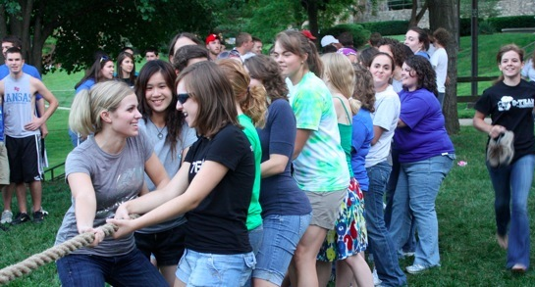
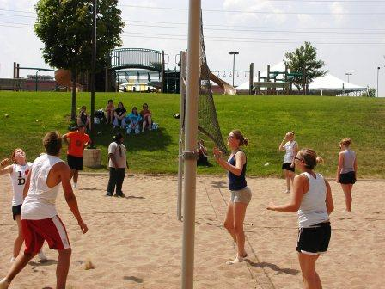
How does it work?
Halls are awarded points based on different events
Events range from sports to picnic activities and everything in between
The male and female halls with the most points win the competition and are awarded a trophy to display in their respective halls

Slide 8
What makes it unique?
Points are also awarded to students based on their attendance at certain events that take place during Hawk Week
This gives students an incentive to attend these events that are beneficial
Students might not attend these events otherwise

Slide 9
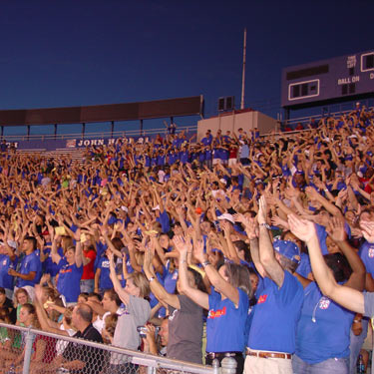
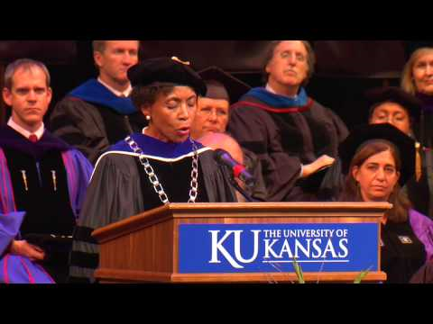
Students receive points for attending:
Traditions Night Opening Convocation

Slide 10
Perspective from a current student
“The Scholarship Hall Olympics were beneficial for getting to know the other people in my hall as well as become acquainted with the entire scholarship system. It gave me a sense of community that scholarship halls have. It offers great opportunities to learn about campus and it blended well with Hawk Week events at the university. It helped me adjust to college life and get to know the campus better.”
-Lee, Freshman

