Slide 1

Does this look infected?
By Jack Mershon
Rebecca Kubat

Slide 2
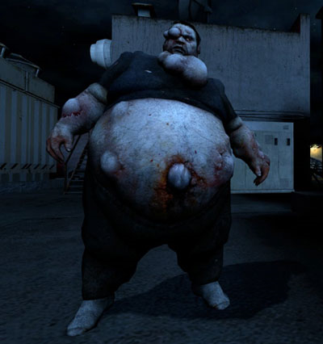
Tips on Identifying signs
Complaining of Fatigue
Emanating smell
Worsening Limp
Greenish Look
Etc.

Slide 3
Game infected or not?

Slide 4

Tips for starting a conversation
Use ‘I’ Statements
Sit on same level, open body language
Be open and honest, understand your not a doctor
Offer different resources

Slide 5
Talking Game
Break into small groups to practice

