Slide 1
Leadership
Magic the Gathering Style
By Lukas Müller

Slide 2

Order
Protection
Justice
Knowledge
Organization
Control
Colors of Magic
Interdependence
Resources
Ecology
Power
Ambition
Selfishness
Impulse
Passion
Chaos

Slide 3
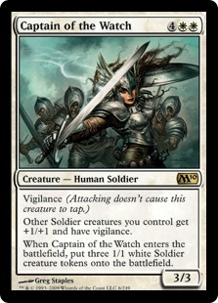
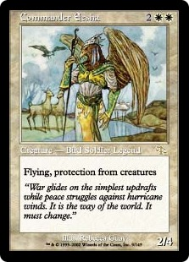
White in game
Protection
First Strike
Regeneration
Control
Creature buff
Vigilance

Slide 4
White Leadership Attributes
In charge
Promote development of new members
Encourages fair discussion during meetings
Balanced
Loyal
Team player
Respectful
Responsible

Slide 5
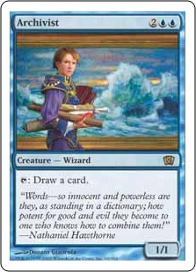
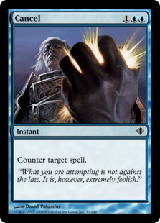
Blue in game
Control
Card Draw
Scrying
Sageing
Counter spells
Flying

Slide 6
Blue Leadership Attributes
Organized
Ver y organized
Likes to plan ahead
Wants to be in control
Supervises activities
On top of things
Perfectionist
Responsible
Anxiety
Worrier
Thinker
Detail oriented

Slide 7
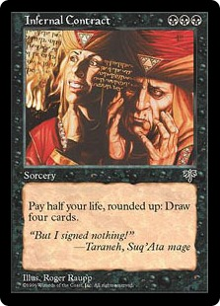
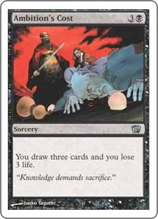
Black in game
Card Draw
Life Loss
Regenerate
Fear
Mana Acceleration
Any ability for a price

Slide 8
Black Leadership Attributes
Ambitious
Very ambitious
Will dedicated all the time needed to get the job done
Risk-taker
Witty

Slide 9
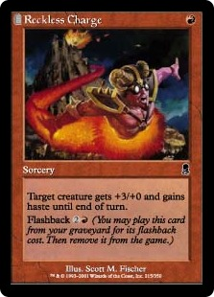
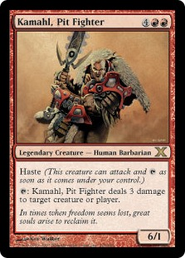
Red in game
Haste
First Strike
Direct Damage

Slide 10
Red Leadership Attributes
Passionate
Very passionate
Gets very excited about activities
Likes to get other people excited as well
Wants to get things done right away
Eager
Unorganized

Slide 11
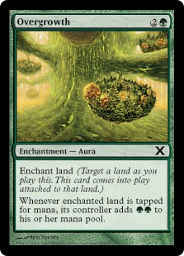
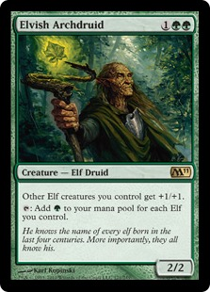
Green in game
Mana Acceleration
Land search
Creature Buff
Trample
Regenerate

Slide 12
Green Leadership Attributes
Resourceful
Likes to work in a group
Are aware of the resources around them
Likes to work together
Likes big events
Supportive

Slide 13
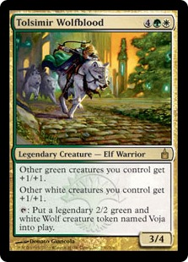
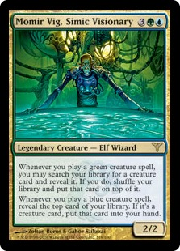
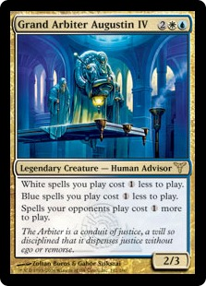
People can be also be combinations of multiple colors.

Slide 14
So what does this mean?
People have different skills that you have to be aware of.
People with different leaderships styles approach problems differently.
People with different leadership styles also put different emphasis on the program they want to do.

Slide 15
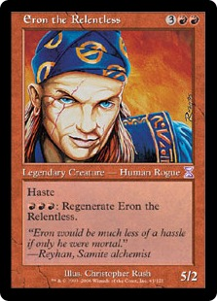
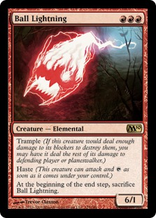
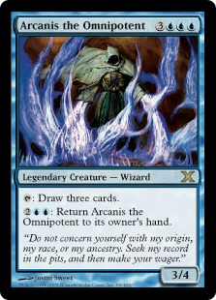
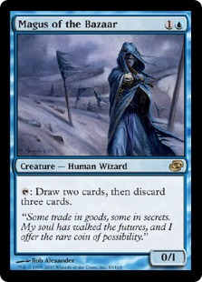
Red vs Blue

Slide 16
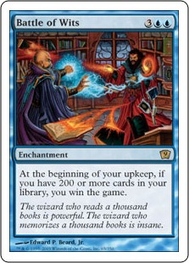
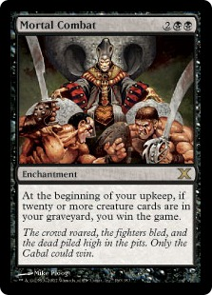
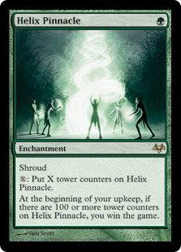
Different ways to reach the goal

Slide 17
How does this pertain to me ?
You have to be aware of different people‘s approaches to tasks.
You need a diverse team to get a problem solved effectively.
You need to be aware your own strengths and weaknesses and those of others.
When doing programs, make them diverse and don‘t do programs for the same group of people all the time.

Slide 18
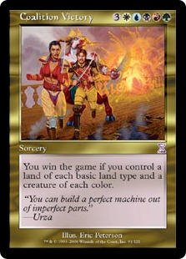

Slide 19
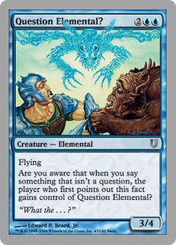
Questions ?

