Slide 1
Cash Elevator
Presented by:
Brooke Qualls
Darrell Boyer

Slide 2
Introduction
Who we are
Why Academic programs are important
  Goals in academic programming

Slide 3
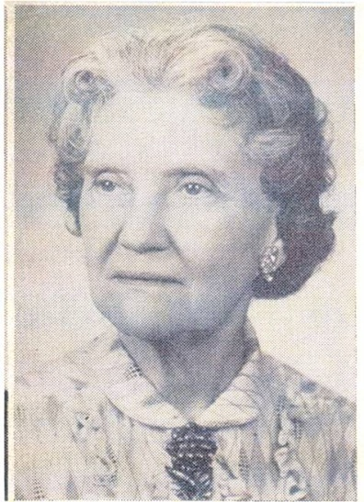
Our Programs
Bertha Bucks
  Ways residents receive them
GPA Competition
Are You Smarter Than Dr. Boyer?
$1
Bertha Bucks
$1
Bertha Bucks

Slide 4
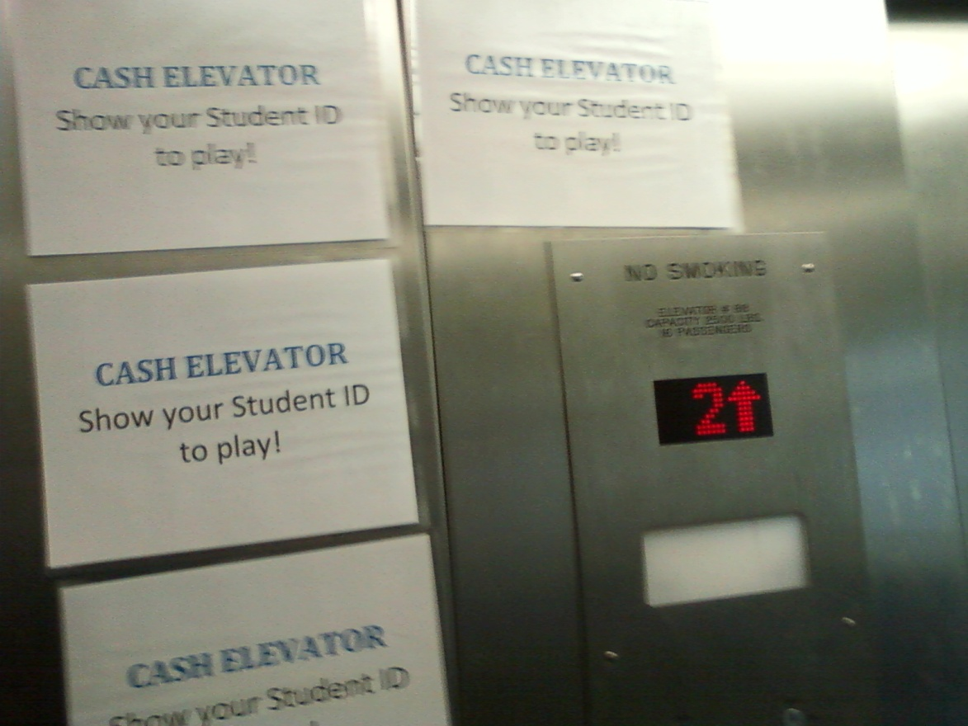
Cash Elevator
What you need
  Elevator, Questions, and Incentive (Bertha Bucks)
  Questions

Slide 5
Brainstorming

